Slide 1
EEET2490: Embedded Systems: Operating Systems And Interfacing
Assignment 1: Serial Console Debugger
Lecturer: Dr. Andrew Smith
Group 12

Slide 2
Outline
Flowchart
Distribution
Timeline
Problems and Solutions
Achievements

Slide 3
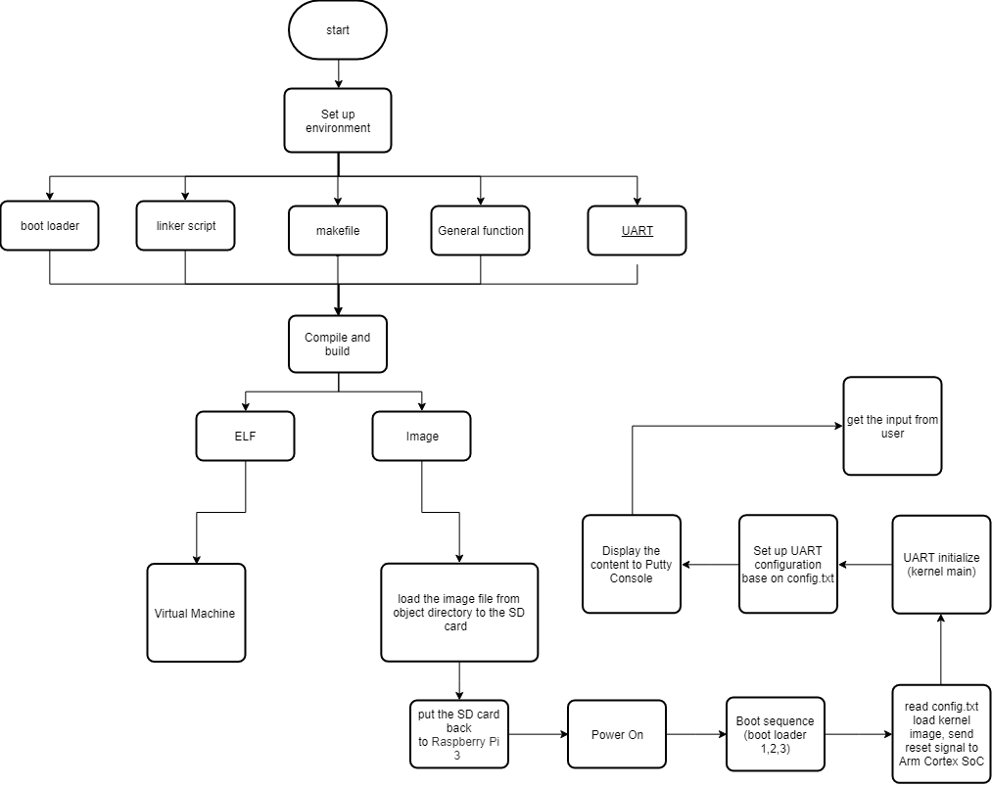
Flowchart

Slide 4
Distribution
Student ID | Student Name | Parts | Distribution
s3678436 | Khoa Dang Le | Research, atoi function, make file | 33%
s3595082 | Bao Gia Le | Research, itoa function, UART | 33%
s3695424 | Anh Duy Ngo | Research dectohex function, linker | 33%

Slide 5
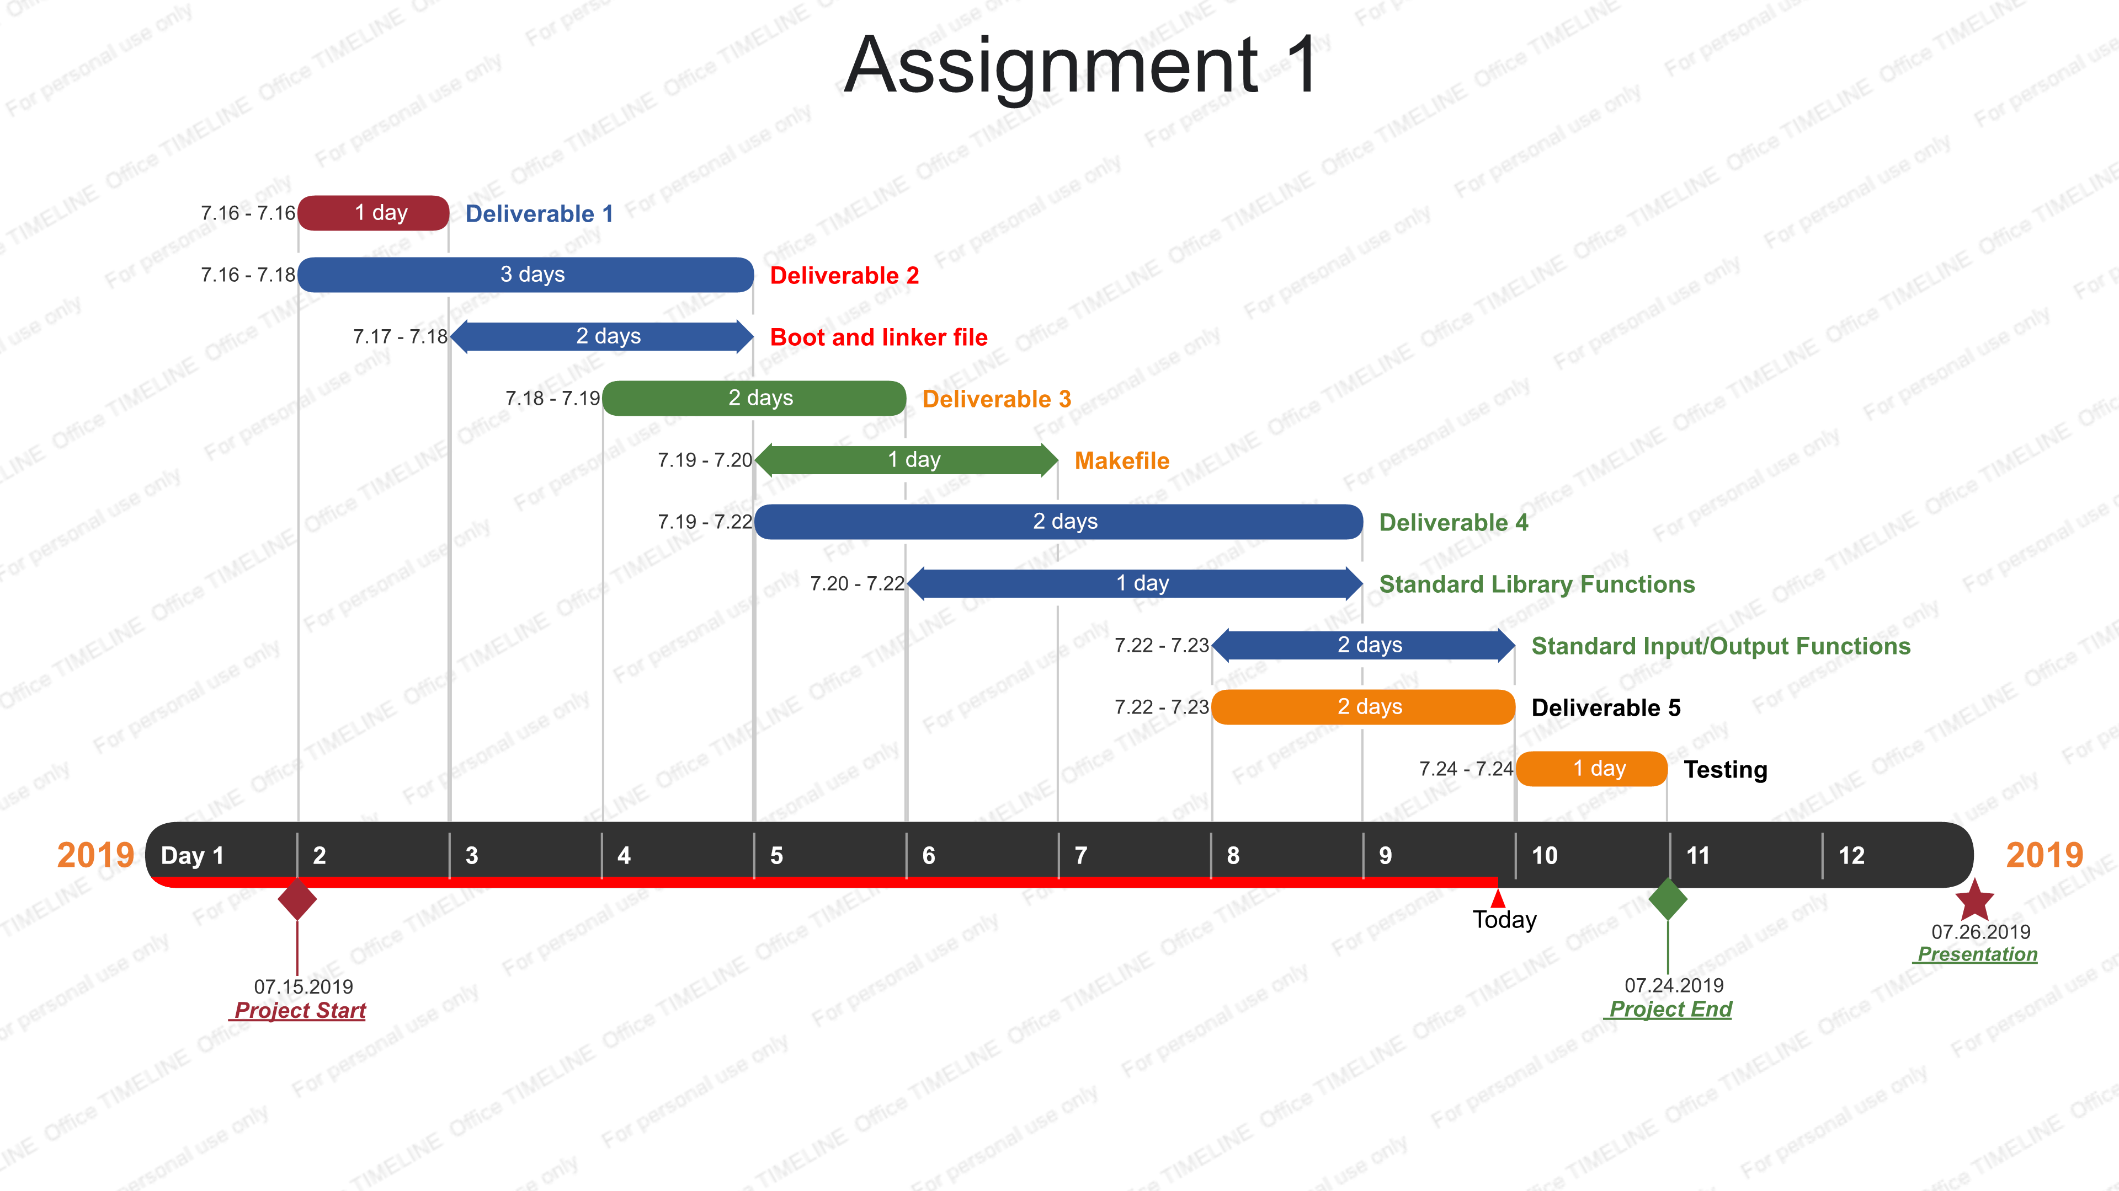
Timeline

Slide 6
Problem and Solution
Problems
Lack of Assembly Knowledge
Set up a C runtime environment
UART0 enable
Solutions
Read Manual Setup of ARM
Understand boot.s, linker script
Read UART0 Document

Slide 7
Problem and Solution
Problems
Time limited due to block mode
The dectohex, itoa display incompletely.
Set up development environment for Mac OS
Solutions
Plan and follow the schedule
Add delay
Manually set up Path

Slide 8
Achievements
Building Operating System
Using Universal Asynchronous Receiver-Transmitter (UART)
Researching Skills
Team Work
Software Project Management

Slide 9
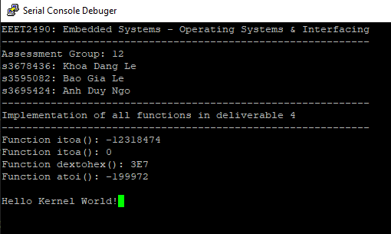
Serial Console Debugger

Slide 10
Questions and answer

